Slide 1
29
Discrete Mathematics
Inverse Functions and Composition of Functions

Slide 2























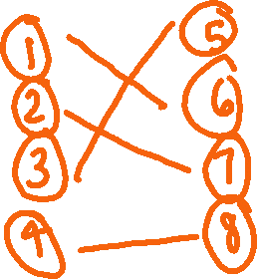


Slide 3















Slide 4













Slide 5



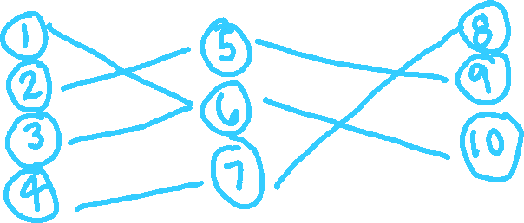



















Slide 6










Slide 7
Up Next…
Useful Functions to Know

